Slide 1
Highly Parallel Tensor Computation for Classical Simulation of Quantum Circuits using GPUs
CSC.458 Parallel and Distributed System
Luchuan Song (lsong11@UR.Rochester.edu)

Slide 2
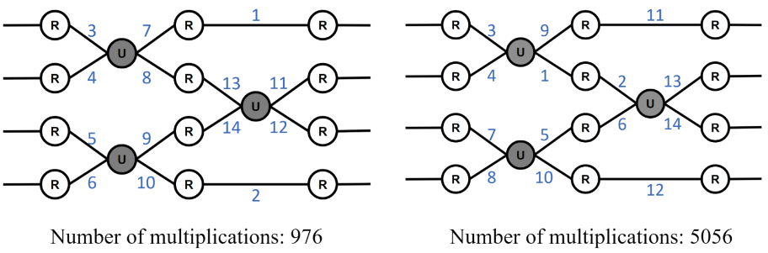
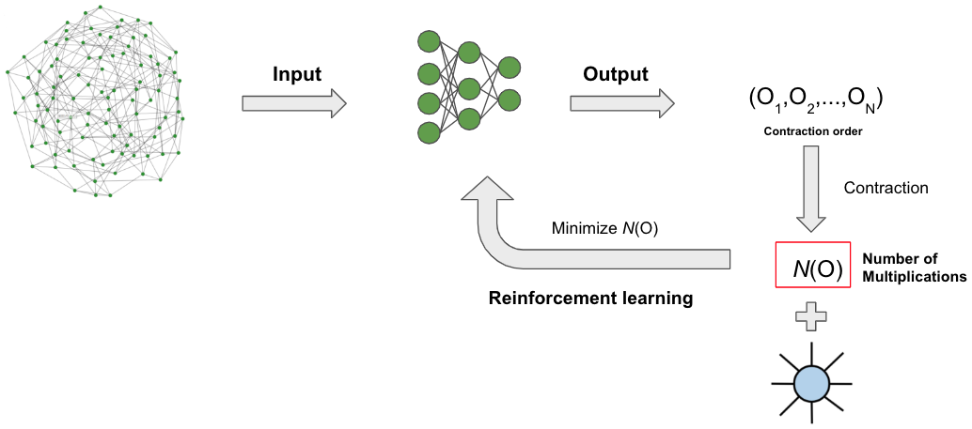
1. What we do for the Tensor Contraction
Designing Tensor Contraction Orders Using Reinforcement Learning
Different contraction paths will lead a significant difference in the number of multiplication
Each paths order is listed in the figure, we can see different contraction paths will lead different multiplication number, so , it is necessary to find a best conctraction paths
2) The design of RL network for contraction order:
We set the number of multiplication as the objective function, now the RL is work on sequential, it is very slow.

Slide 3
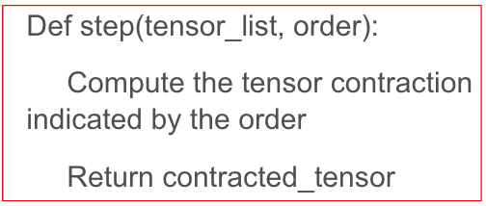
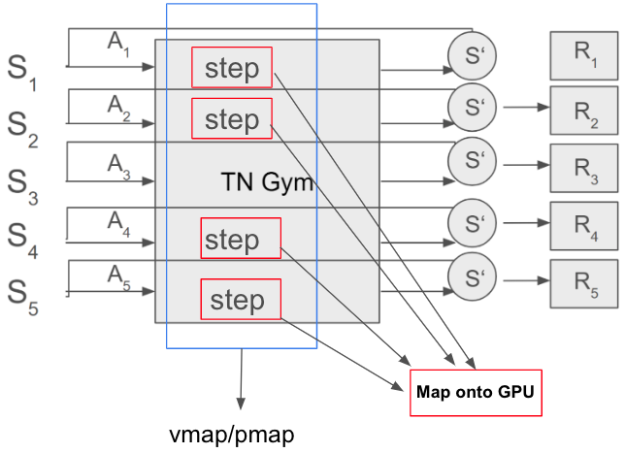
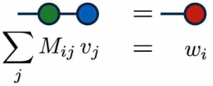
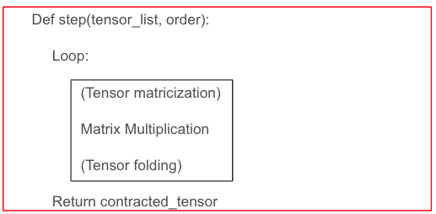
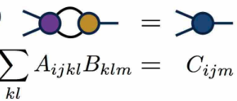
1. What we do for the Tensor Contraction
Using the vectorized environments for speed up the RL
i) The key for the speed of RL is sample in the Replay Buffer, it involves sampling from each buffer, so we design a method to vectorize this process.
ii) On each sampling step, we give an GPU thread for that, than, we can parallelize this sampling process by using multiple GPU processes.
Tensor learning primitives
Fold/Unfold, Einsum, mode_dot/contraction

Slide 4
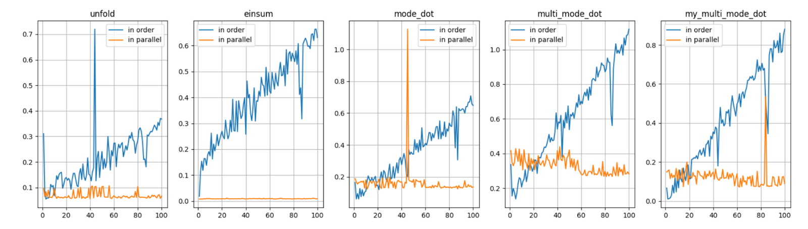
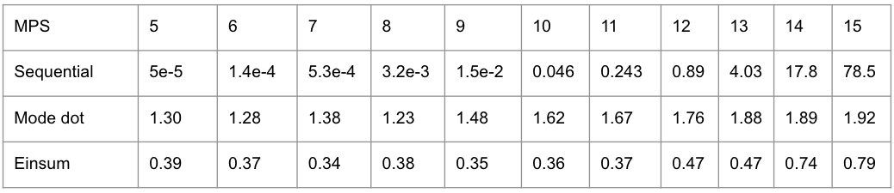
2. Some Results

Slide 5
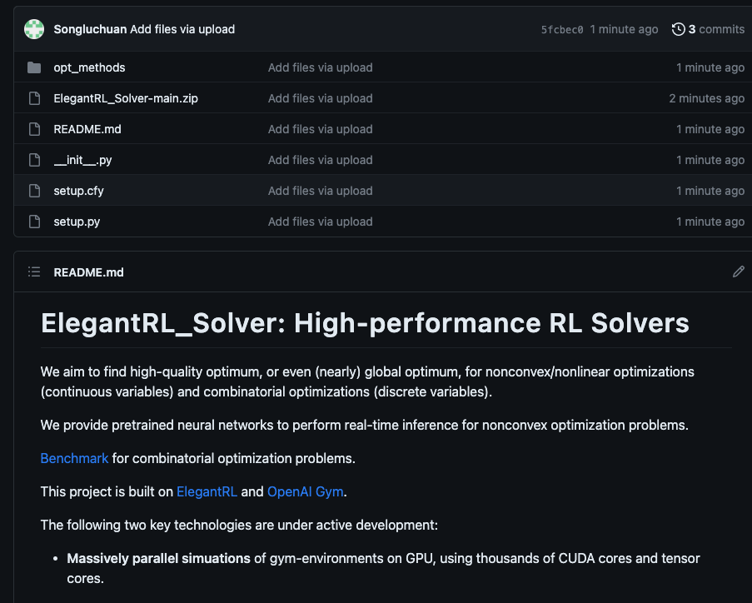
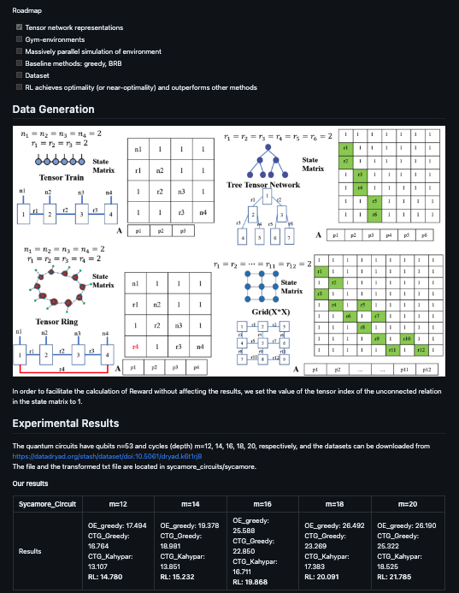
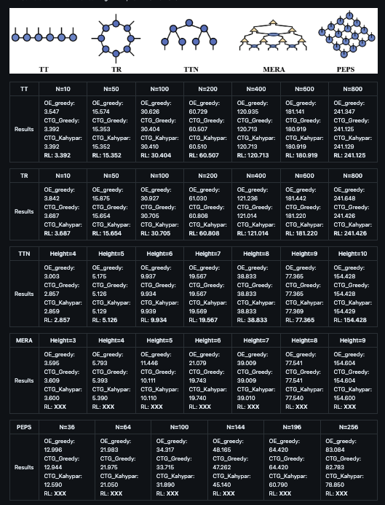
2. Some Results

